Slide 1


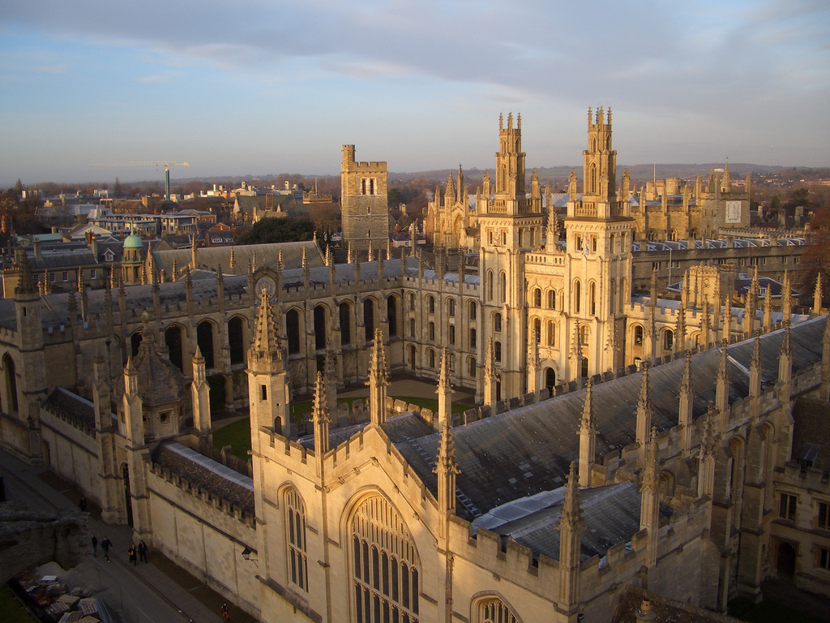
Hypergraph Propagation and Community Selection for Objects Retrieval
Guoyuan An, Yuchi Huo, Sung-Eui Yoon

Slide 2

Hypergraph Propagation and Community Selection for Objects Retrieval
Guoyuan An
(anguoyuan@kaist.ac.kr)
https://sgvr.kaist.ac.kr
Notes:
1

Slide 3
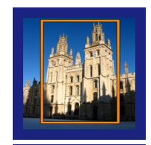
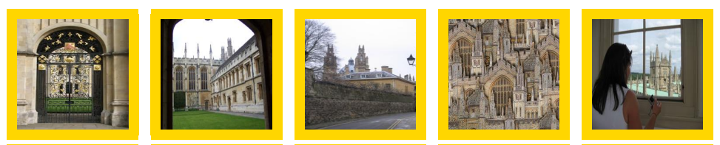
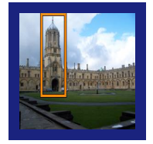
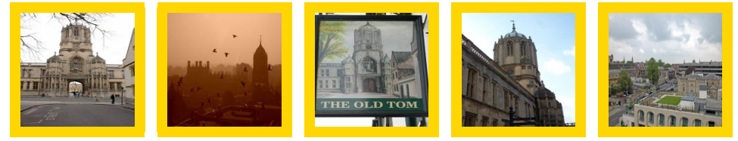
Challenging in revisited Oxford & Paris
Query
Hard cases
The yellow boxes are the hard cases for the each query.

Slide 4
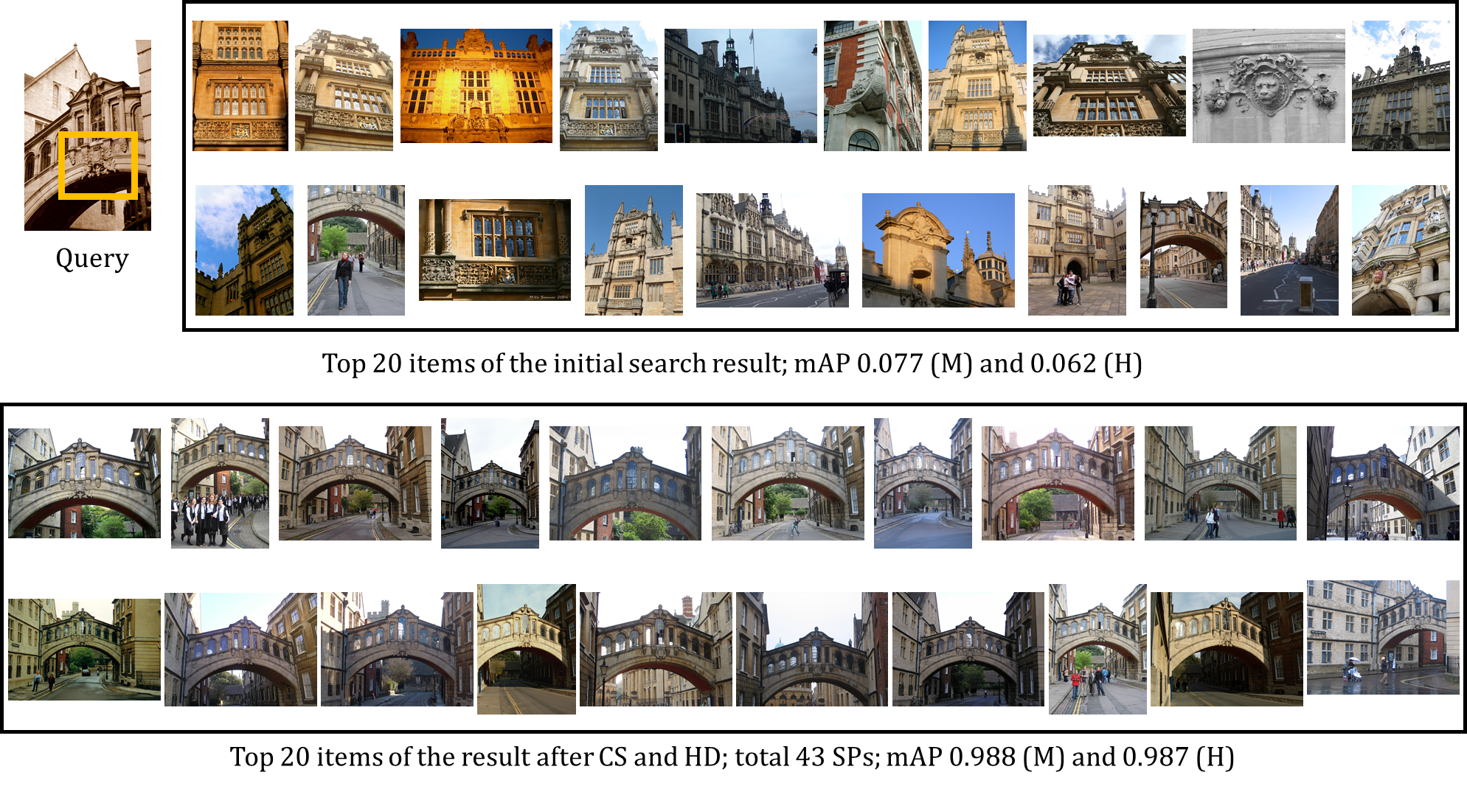
Current achievement

Slide 5
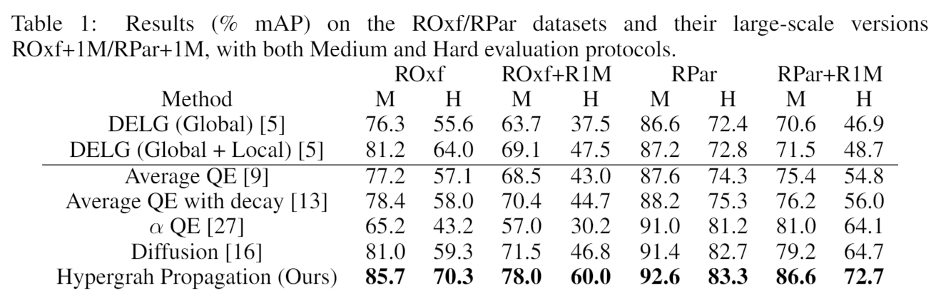
SOTA and the opportunities
We have the current SOTA result.
There are still a lot challenges / opportunities.
Check our result to find more opportunities:

Slide 6
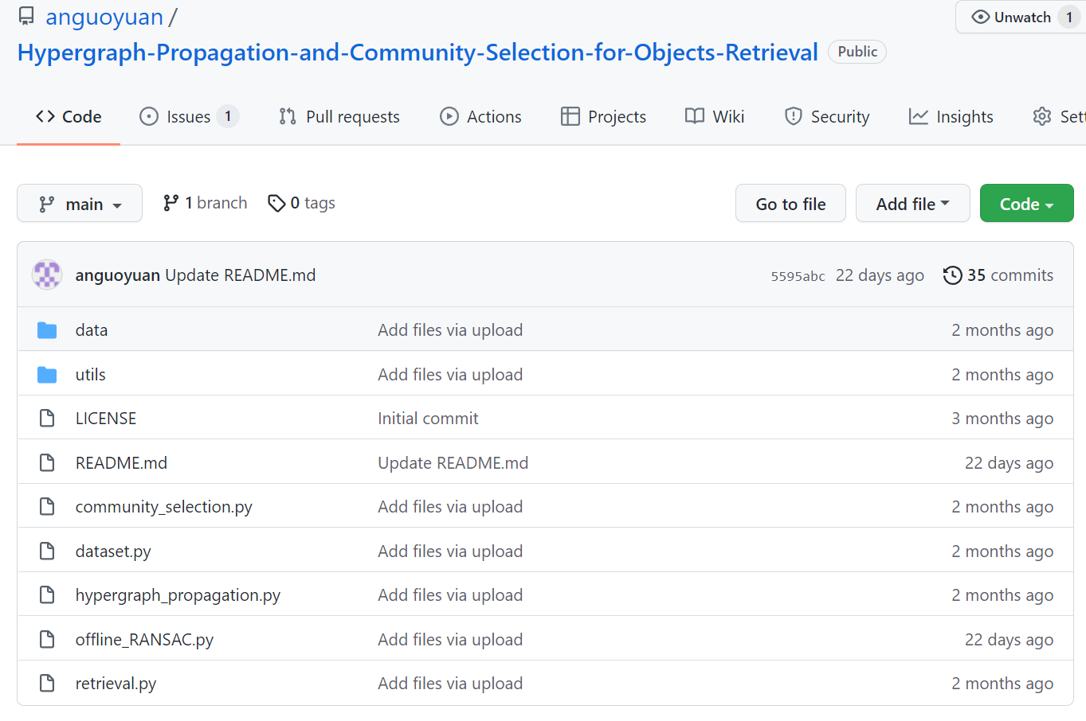
Tips for reading the code
Algorithm 2
Algorithm 1
run

Slide 7
Content
Review: pipeline of image retrieval
Problem of diffusion
Solution: hypergraph propagation
Problem of spatial verification
Solution: community selection

Slide 8
Review: pipeline of image search

Slide 9
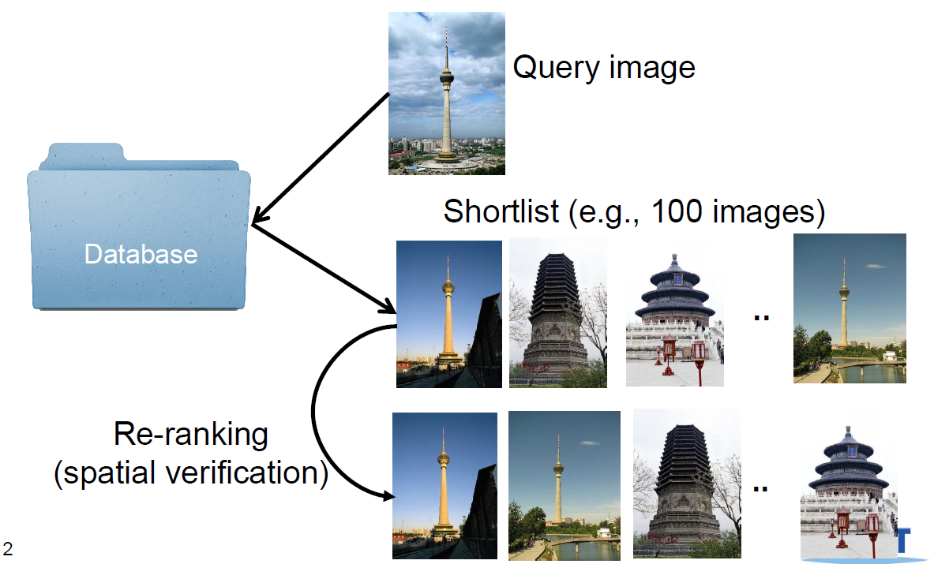
Pipeline of image retrieval
Re-ranking:
Diffusion & query expansion
Spatial verification

Slide 10
Diffusion and its issue
We only introduce the high level idea about diffusion here.
For the detailed explanation, check: https://github.com/anguoyuan/Diffusion-for-retrievl-python.git

Slide 11
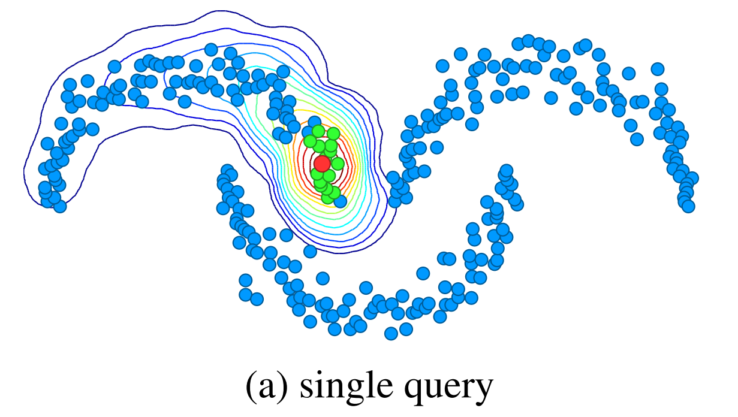
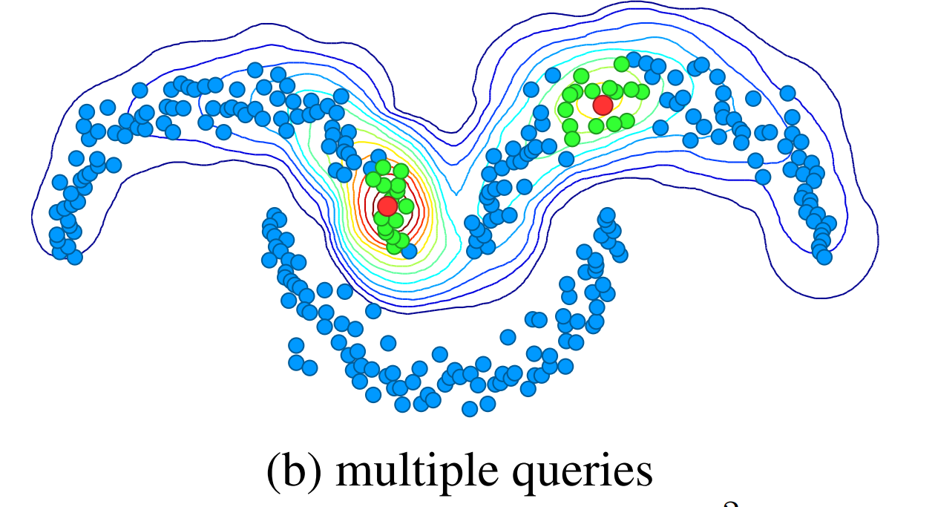
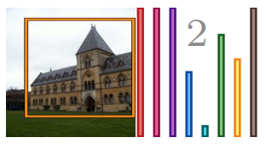
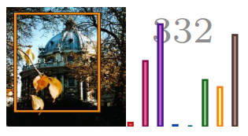
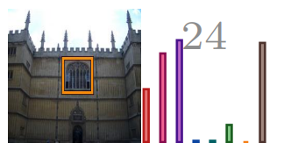
Problem
Diffusion captures the image manifold in the feature space.
It is a popular and powerful technique to improve the quality of image retrieval.
Iscen, … Efficient Diffusion on Region Manifolds: Recovering Small Objects with Compact CNN Representations, CVPR 2017
However, some works observed that diffusion degrade the retrieval performance of the hard cases.
0.80
Performance degrades
0.61
0.4
0.34
0.15
0.02
mAP
before diffusion
before diffusion
before diffusion
after diffusion
after diffusion
after diffusion
Radenovic, … Efficient Diffusion on Region Manifolds: Recovering Small Objects with Compact CNN Representations, CVPR 2018

Slide 12

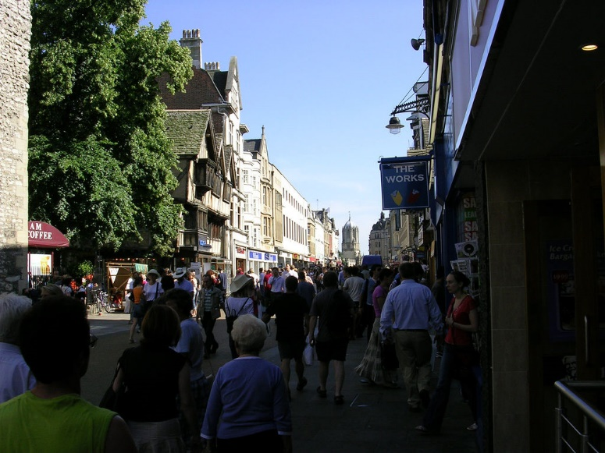
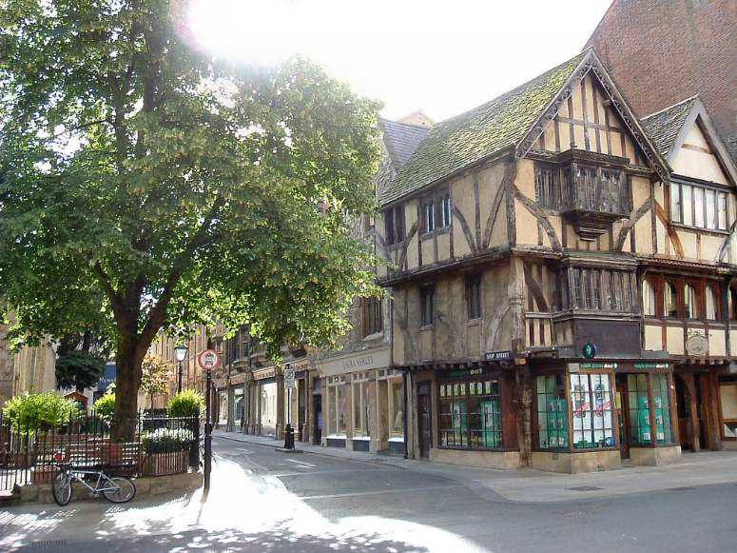
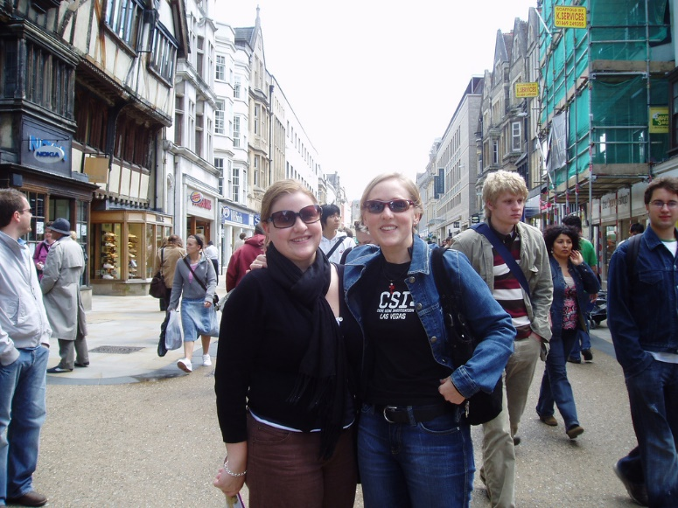
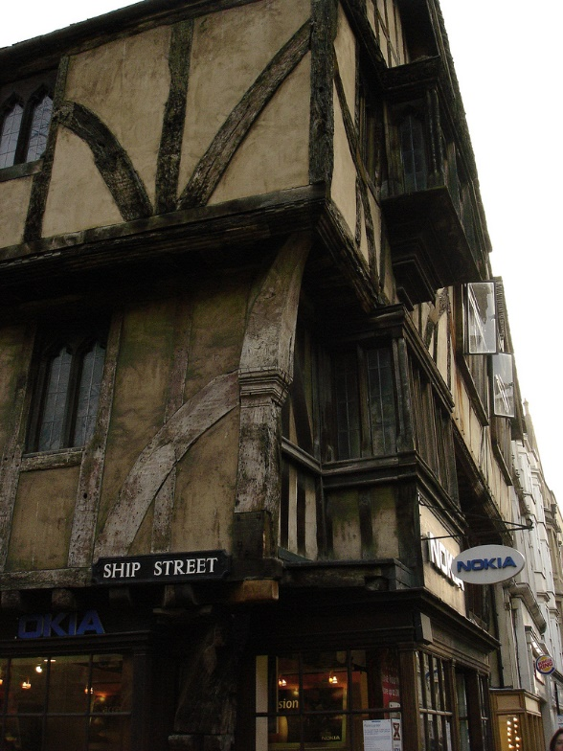
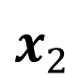
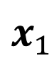
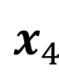
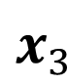
How does diffusion work?
Manifold: even though the images of the sequence contain the same object, the descriptors may be completely unrelated after a certain point.
Diffusion performs similarity propagation to improve the performance.
$$x_{3}$$
$$x_{1}$$
$$x_{2}$$
$$x_{4}$$
Notes:
Information diffuse from x4 to x1, x2, and x3.

Slide 13
How does diffusion work?
Think about a droplet of ink into the water.
Node 4 will get larger ranking score (more ink color) than node 1, 2, and 3.
Same theory with Markov Chain, PageRank,…
1
The blue node is the initial query, which is the droplet of ink.
4
2
3

Slide 14
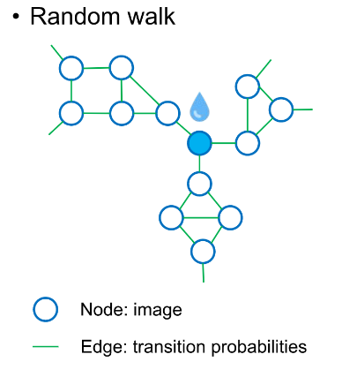
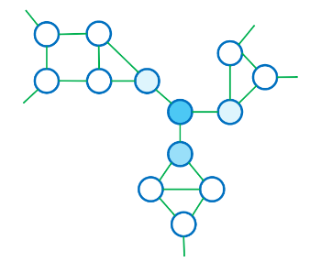
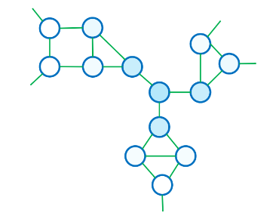
How does diffusion work?
Diffusion uses the structure information to rank the database images.

Slide 15
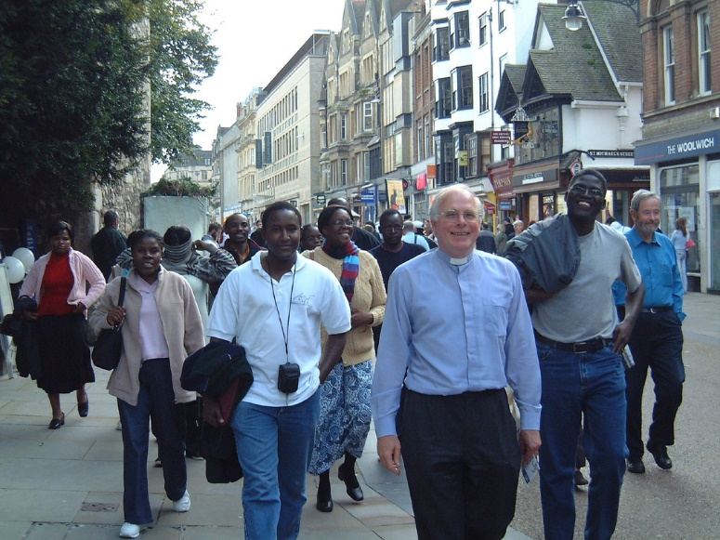
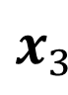
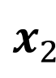
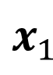
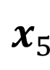
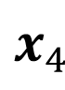
Where does diffusion fail?
However, if the dataset is difficult, some images in a manifold may not contain a same object.
Thus, diffusion inevitably includes false positives.
$$x_{3}$$
$$x_{1}$$
$$x_{2}$$
false positives
$$x_{4}$$
$$x_{5}$$

Slide 16
Solution: hypergraph propagation

Slide 17
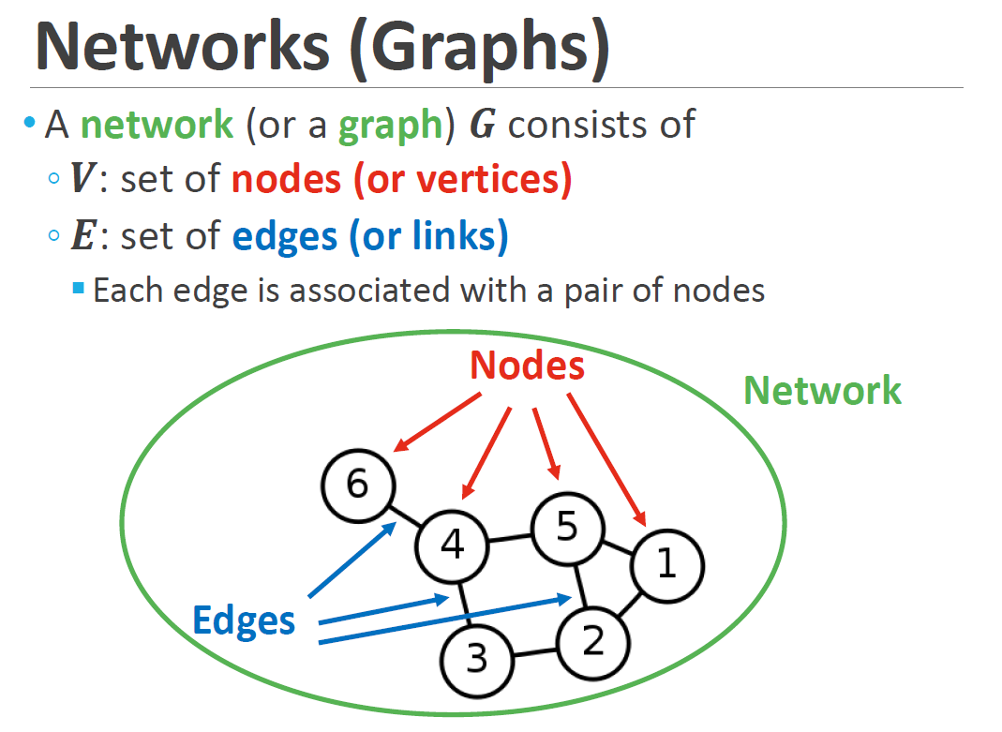
Kijung Shin, … AI 607 Graph Mining and Social Network Analysis.

Slide 18
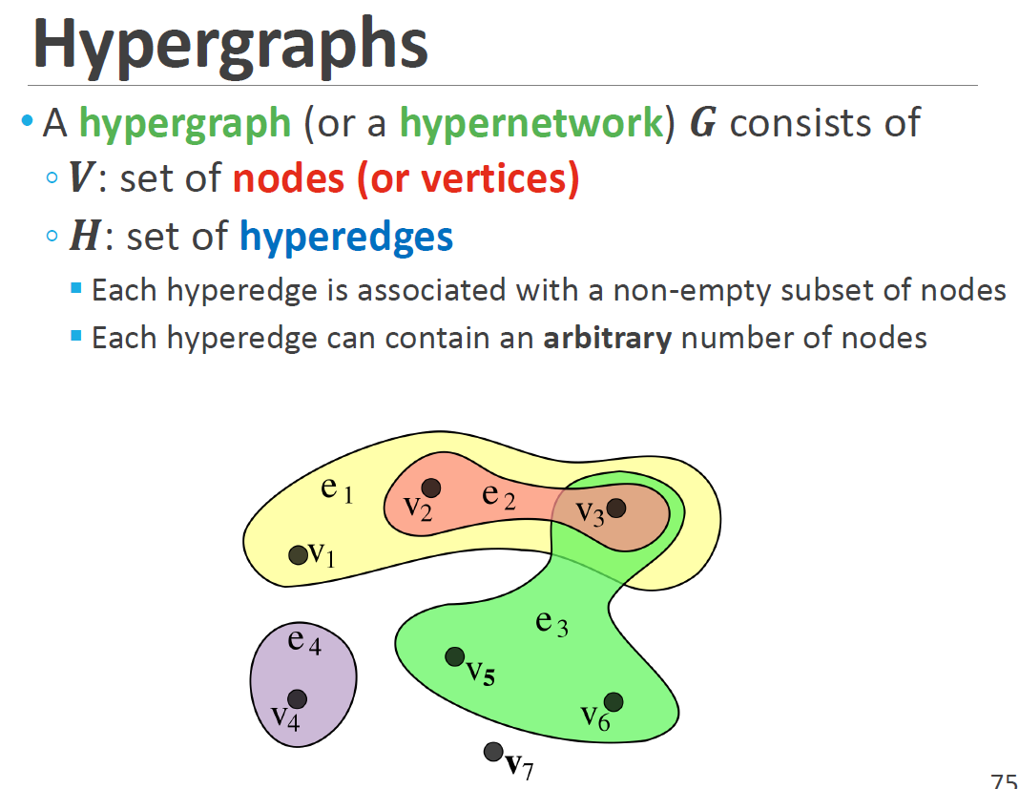
Kijung Shin, … AI 607 Graph Mining and Social Network Analysis.

Slide 19





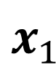
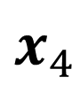
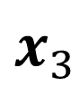
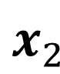
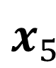
Solution: hypergraph
$$x_{3}$$
$$x_{1}$$
$$x_{2}$$
$$x_{4}$$
$$x_{5}$$

Slide 20
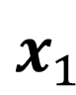
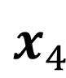
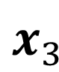
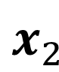
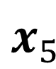
Solution: hypergraph
We treat each local feature as a node, and connect these nodes using hyperedges.
The relation of local features are found by spatial verification.
Recall: two representative reranking methods are diffusion and spatial verification.
$$x_{3}$$
$$x_{1}$$
$$x_{2}$$
$$x_{4}$$
$$x_{5}$$

Slide 21
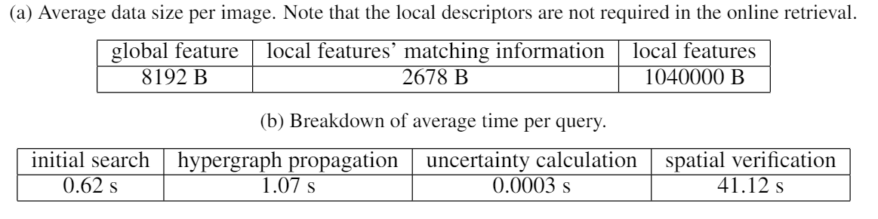
Quantitative result
Accuracy:
significant performance improvement
Memory:
no much extra storage required; smaller than the global feature
Speed:
significant performance improvement

Slide 22
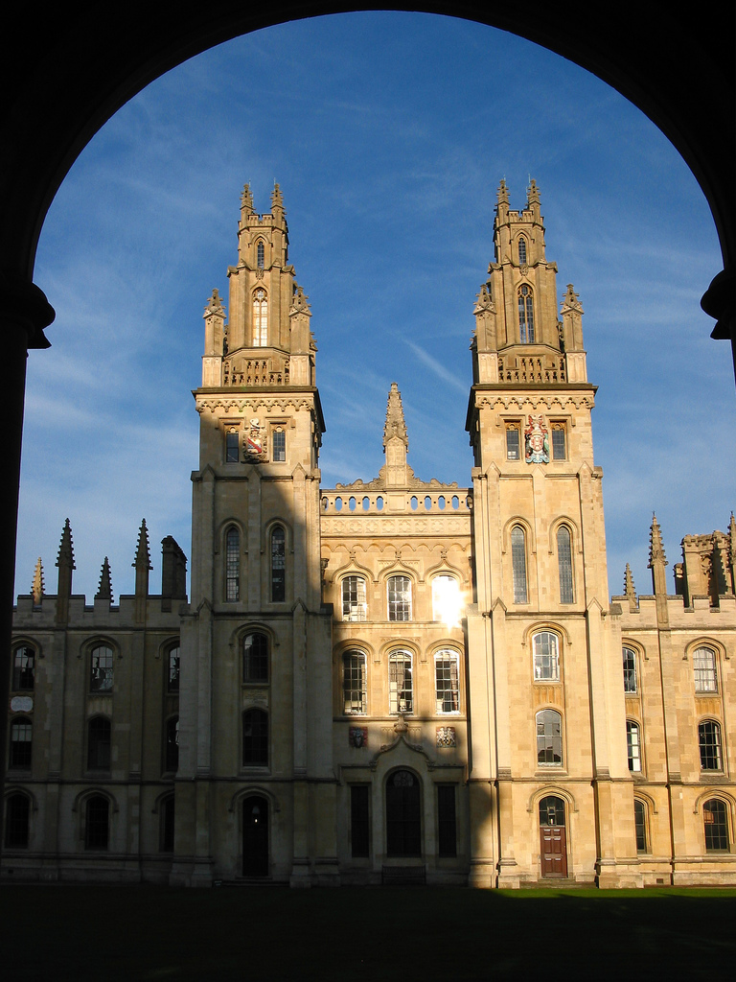
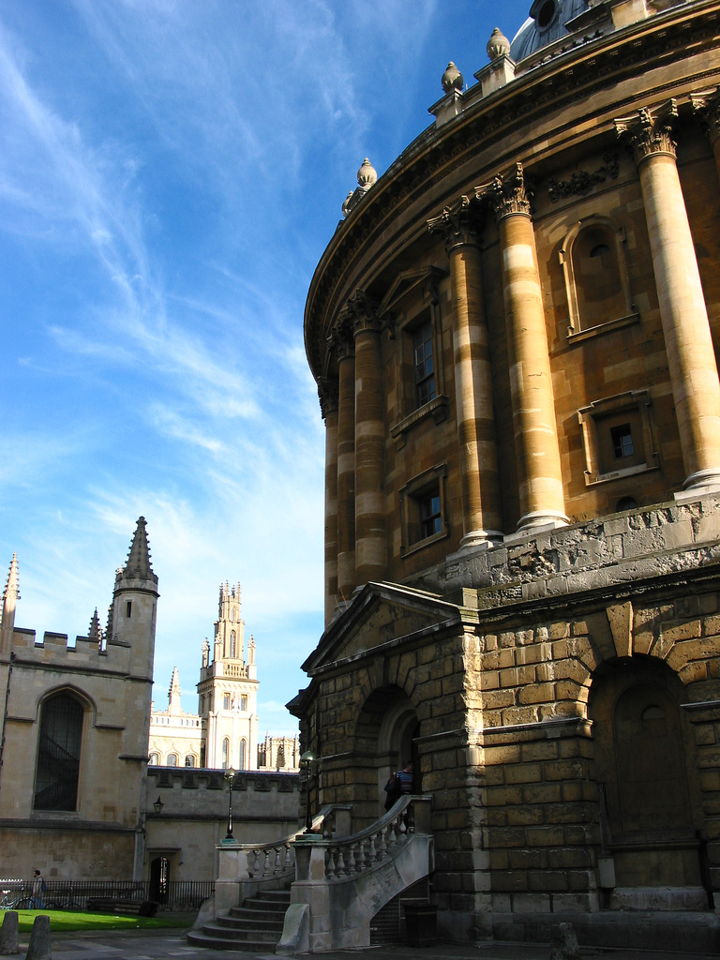
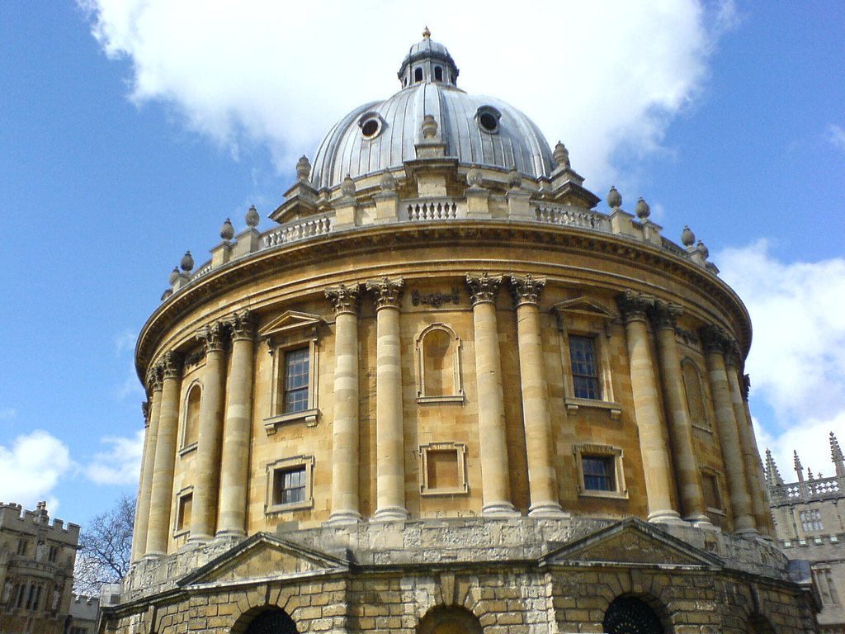
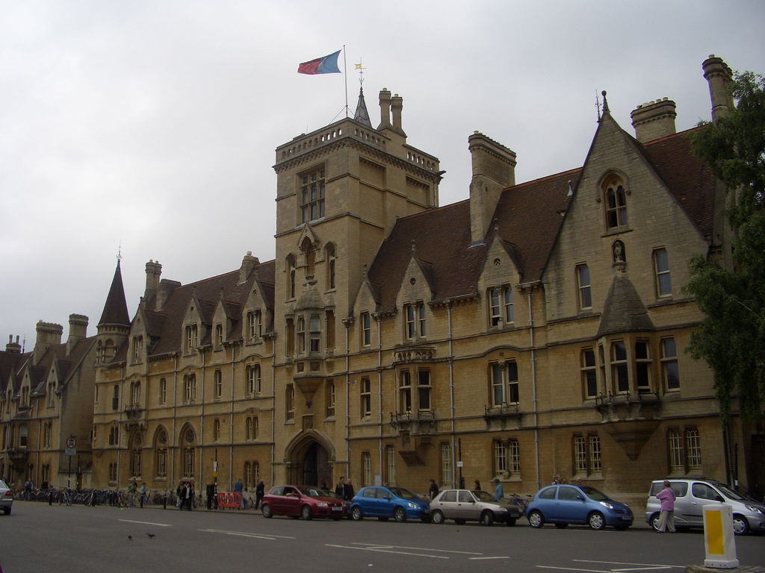
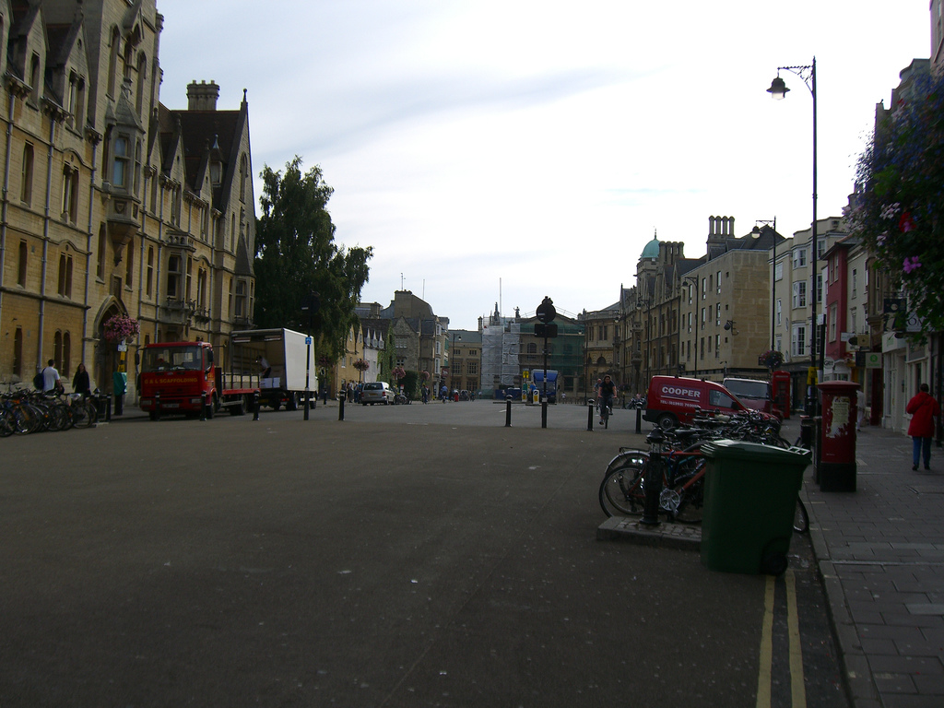
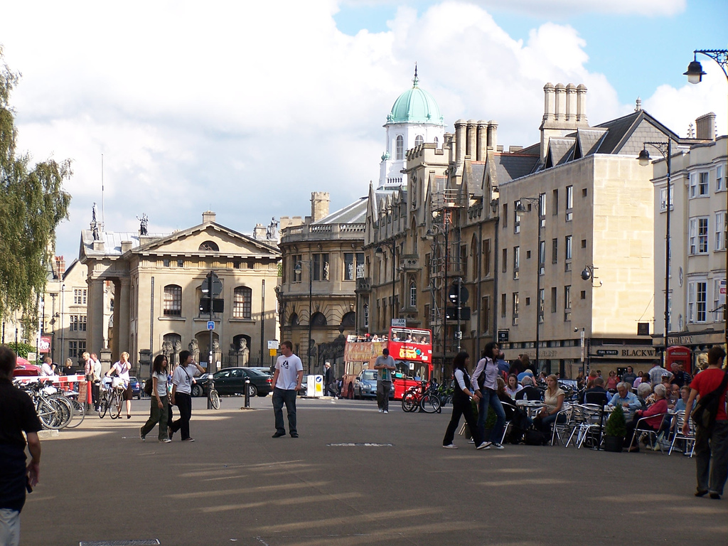
Qualitative result
For each query, we correctly only accept the true positive (TP) and reject the false positive (FP) in the initial ranking list.
Query
TP
FP
Query
TP
FP

Slide 23
Problem of spatial verification

Slide 24


Estimate the accuracy of initial search
Estimating the accuracy of initial search is important for
Reranking with diffusion
Search engine improvement
User experience.
Traditional way is doing the geometric verification for the top 100 searched images.
very slow
geometric verification

Slide 25
Solution: community selection

Slide 26
Predict the initial search quality
Reranking, especially spatial verification, is time consuming.
However, not all initial rankings need reranking. If we can predict the initial search quality in advance, we can only do the reranking for low-quality initial search and directly accept the high-quality initial search.
We propose community selection technique to predict the search quality.
Not that this process requires no ground truth or user feedback.
This process is very fast.

Slide 27


Graph approach: community selection
We observe that the images containing a same object usually belong to a same community.
By checking whether the searched images are in the same community, we can evaluate the quality of the initial search without query time spatial verification.
$$Q_{2}$$
$$Q_{1}$$
2
1
4
3
2
1
5
6
community
6
3
4
image
5

Slide 28
How to find the community?
It is not necessary detect all communities in the database in advance.
Instead, we detect the connected components among the top K (K=6 in the follow figure) of each query.
And then calculate the entropy (recall Shannon's theory) among the components. Higher entropy means higher uncertainty and low quality.
$$Q_{2}$$
$$Q_{1}$$
2
1
4
component 1 for Q1
Component 2 for Q1
Entropy is low
3
2
1
5
6
6
3
4
component 1 for Q1 Component 2 for Q1
Entropy is high
5

Slide 29

Quantitative result
The uncertainty index predicts the quality of initial search without spatial verification or any user feedback.
The speed of calculating the uncertainty is very fast.

Slide 30




Thank you
Detail and code: https://sgvr.kaist.ac.kr/~guoyuan/hypergraph_propagation/

